Slide 1
MACHINE LEARNING AS A SERVICE
INFO7390 15974 Advances Data Sci/Architecture
By
Abhinav Tiwari
Dharit Shah
Nilesh Nerkar
(Team 2)

Slide 2
Agenda
Machine Learning Pipeline
MLAAS
How MLaaS makes it easy?
Available Machine Learning Services
Azure ML Studio
What is Amazon SageMaker?
BigML & AutoML

Slide 3
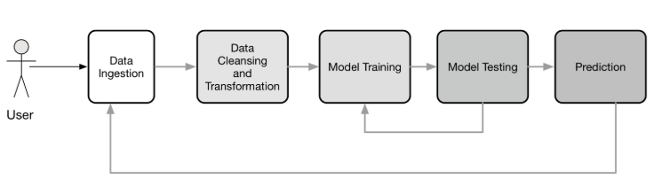
Machine Learning Pipeline

Slide 4
Machine Learning As A Service
The same as SaaS or BaaS solutions, machine learning as a service platforms are intended to handle nearly all matters connected with infrastructure
Developers are not obligated to messing with model training and evaluation, as well as worry about further cloud-based predictions
MLaaS makes it easy and automate the pipeline depending upon the service which we use

Slide 5
Available Machine Learning Services
Azure Machine Learning
Amazon Machine Learning
H2O AI
BigML
Databricks
Google Prediction API
IBM Watson

Slide 6
What is Azure ML Studio?
Azure ML is a visual interface contributing to model building and training, as well as choosing algorithms to apply
The service itself is focused around the ML Studio framework that allows you to create modular solutions
No Software to install, only web browser is needed
Possibility to develop without writing code
Easy deployment and usage using Rest API
Easy collaboration on Azure ML projects

Slide 7
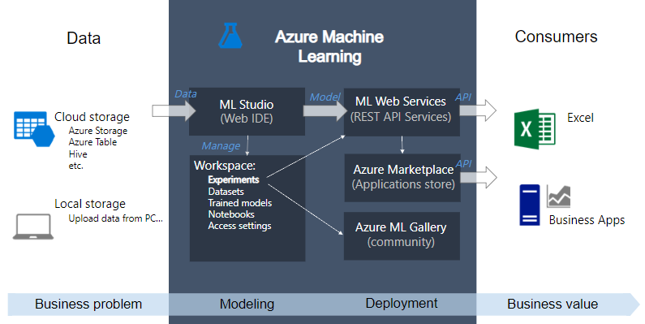
Overview Azure ML Studio

Slide 8
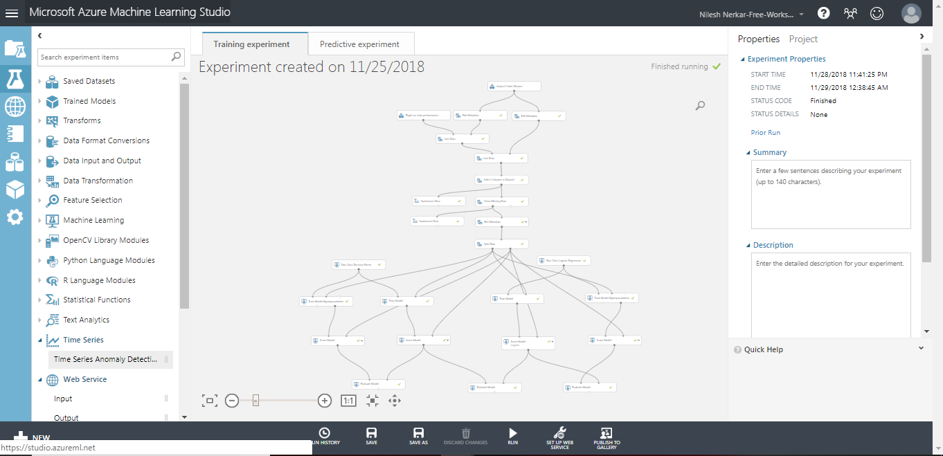
Azure ML Studio Demo

Slide 9
Limitations in Azure ML Studio
Maximum storage volume per account is limited
Maximum dataset volume is 10 GB
Throttled Policy is that only 20 concurrent request per endpoint, max endpoint count 10K
Its like a Black Box, no debug, no scala, C++, C#
One should know their own right algorithm to be used

Slide 10
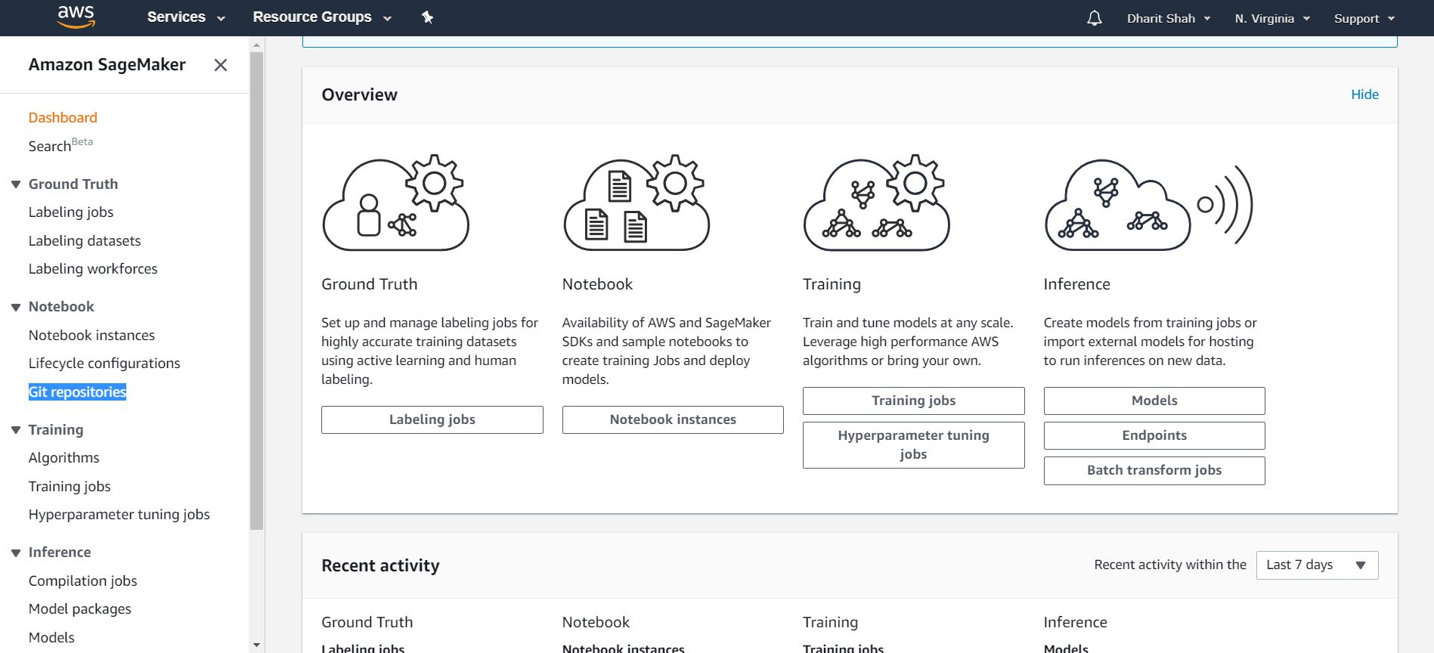
What is Amazon SageMaker?

Slide 11
Amazon SageMaker Features
Build
Build highly accurate training datasets
Managed Notebooks for Authoring Models
Built-in, High Performance Algorithms
Broad Framework Support
Broad Framework Support
Train
One-click Training
Automatic Model Tuning Broad Framework Support
Train Once, Run Anywhere
Deploy
One-click Deployment
Automatic A/B Testing
Fully-managed Hosting with Auto Scaling

Slide 12
Amazon SageMaker Demo

Slide 13
AutoML Services
AutoML provides methods and processes to make Machine Learning available for non-Machine Learning experts, to improve efficiency of Machine Learning and to accelerate research on Machine Learning
AutoML helps us in automating tasks whose complexity can often baffle non-ML experts, like :
Preprocess and clean the data.
Select and construct appropriate features.
Select an appropriate model family.
Optimize model hyperparameters.
Postprocess machine learning models.
Critically analyze the results obtained.

Slide 14
H2O AI
Overview :
H2O is an open-source software for big-data analysis.
H2O allows users to fit thousands of potential models as part of discovering patterns in data.
Salient Features :
It automates the model selection and validation process in the Machine Learning pipeline through its AutoML framework.
H2O is built on top of the Hadoop distributed framework, thereby enabling faster data processing on its clusters.
It also has functions for exporting the trained models as JAVA POJO’s for productionizing the model once it has been validated.

Slide 15
H2O AI DEMO
Regression on Iowa Housing Price Data Set
To predict the SalePrice of the house
Classification on Titanic Data Set
To predict the chance of Survival

Slide 16
BigML
Overview :
BigML is MLaaS, which provides robustly-engineered Machine Learning algorithms proven to solve real world problems, through a simple and elegant web interface.
Features :
Like H2o it provides an OptiML library for AutoML pupose.
It is platform independent i.e. it can access data from AWS, Google Drive, etc.
The Web UI is extremely intuitive and easy to use.
The models are very interpretable

Slide 17
BigML DEMO
Regression on Iowa Housing Price Data Set
To predict the SalePrice of the house
Classification on Titanic Data Set
To predict the chance of Survival

